Slide 1
GPS L2C SDR

Slide 2
Introduction (1/8)
GPS signal parameters
Signals |  | Code Freq. | Code Len. | Nav. Data |  | Modulation | Freq. | Band Width | Min. Received Power[dBW]
 |  | [Mcps] | [chip] | Type | D(t)/d(t)[bps] |  | [MHz] | [MHz]
L1 C/A |  | 1.023 | 1023 | NAV | 50/50 | BPSK-R(1) | 1572.42 | 2.046 | -158.5
L1 P(Y) |  | 10.23 | 7 days | NAV | 50/50 | BPSK-R(10) |  | 20.46 | -161.5
L1 M |  | 5.115 | Unknown | MNAV | Unknown | BOC(10,5) |  | 30.69 | Unknown
L1C | L1 CD | 1.023 | 10230 | CNAV-2 | 50/100 | BOC(1,1) |  | 4.092 | -157.0
 | L1 CP | 1.023 | 10230×1800 | Pilot Channel |  | TMBOC(6,1,4/33) |  | 14.332
L2 P(Y) |  | 10.23 | 7 days | NAV | 50/50 | BPSK-R(1) | 1227.6 | 20.46 | -161.5
L2C | CM | 0.5115×2 | 10230 | CNAV | 25/50 | BPSK-R(1) |  | 2.046 | -160.0
 | CL |  | 767250 | Pilot Channel
L2M |  | 5.115 | Unknown | MNAV | Unknown | BOC(10,5) |  | 30.69 | Unknown
L5C | L5I | 10.23 | 10230×10 | CNAV | 50/100 | QPSK-R(10) | 1176.45 | 20.46 | -157.9
 | L5Q | 10.23 | 10230×20 | Pilot Channel |  |  |  | 20.46

Slide 3
Introduction (2/8)
List of SVs transmitting L2C (*)
Satellite | Launch (UTC) | Launch site | Block | № | SVN | PRN | Slot
USA-266 | 2/5/2016 | CCAFS SLC-41 | IIF | 12 | 70 | 32 | F5
USA-265 | 10/31/2015 | CCAFS SLC-41 | IIF | 11 | 73 | 10 | E6
USA-183 | 9/26/2005 | CCAFS SLC-17A | IIRM | 1 | 53 | 17 | C4
USA-190 | 9/25/2006 | CCAFS SLC-17A | IIRM | 2 | 52 | 31 | A2
USA-192 | 11/17/2006 | CCAFS SLC-17A | IIRM | 3 | 58 | 12 | B4
USA-196 | 10/17/2007 | CCAFS SLC-17A | IIRM | 4 | 55 | 15 | F2
USA-199 | 12/20/2007 | CCAFS SLC-17A | IIRM | 5 | 57 | 29 | C1
USA-201 | 3/15/2008 | CCAFS SLC-17A | IIRM | 6 | 48 | 7 | A4
USA-206 | 8/17/2009 | CCAFS SLC-17A | IIRM | 8 | 50 | 5 | E3
USA-213 | 5/28/2010 | CCAFS SLC-37B | IIF | 1 | 62 | 25 | B2
USA-232 | 7/16/2011 | CCAFS SLC-37B | IIF | 2 | 63 | 1 | D2
USA-239 | 10/4/2012 | CCAFS SLC-37B | IIF | 3 | 65 | 24 | A1
USA-242 | 5/15/2013 | CCAFS SLC-41 | IIF | 4 | 66 | 27 | C2
USA-248 | 2/21/2014 | CCAFS SLC-37B | IIF | 5 | 64 | 30 | A3
USA-251 | 5/17/2014 | CCAFS SLC-37B | IIF | 6 | 67 | 6 | D4
USA-256 | 8/2/2014 | CCAFS SLC-41 | IIF | 7 | 68 | 9 | F3
USA-258 | 10/29/2014 | CCAFS SLC-41 | IIF | 8 | 69 | 3 | E1
USA-260 | 3/25/2015 | CCAFS SLC-37B | IIF | 9 | 71 | 26 | B5
USA-262 | 7/15/2015 | CCAFS SLC-41 | IIF | 10 | 72 | 8 | C5
19 Svs
(*) Wikipedia: https://en.wikipedia.org/wiki/List_of_GPS_satellites

Slide 4
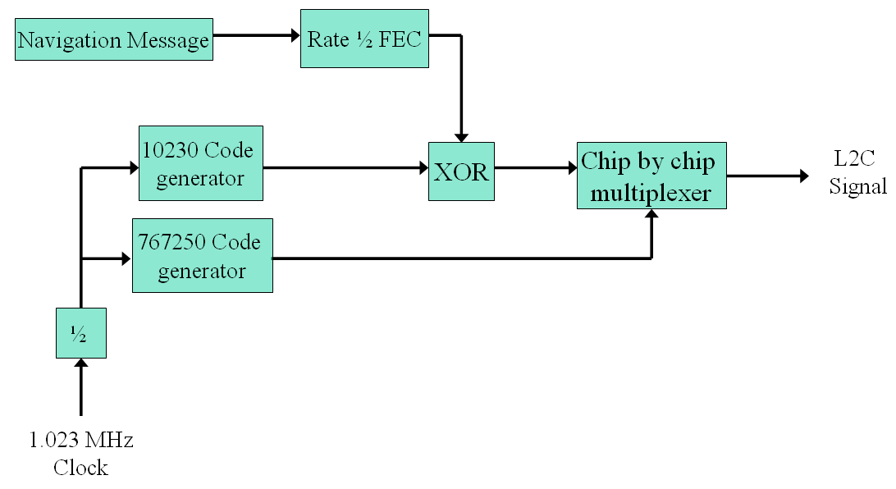
Introduction (3/8)
Modulation scheme for the GPS L2 Signals
CM/CL Codes:
Time multiplexed
Chipping rate is doubled
Synchronized with the X1 epochs of the P-code.

Slide 5
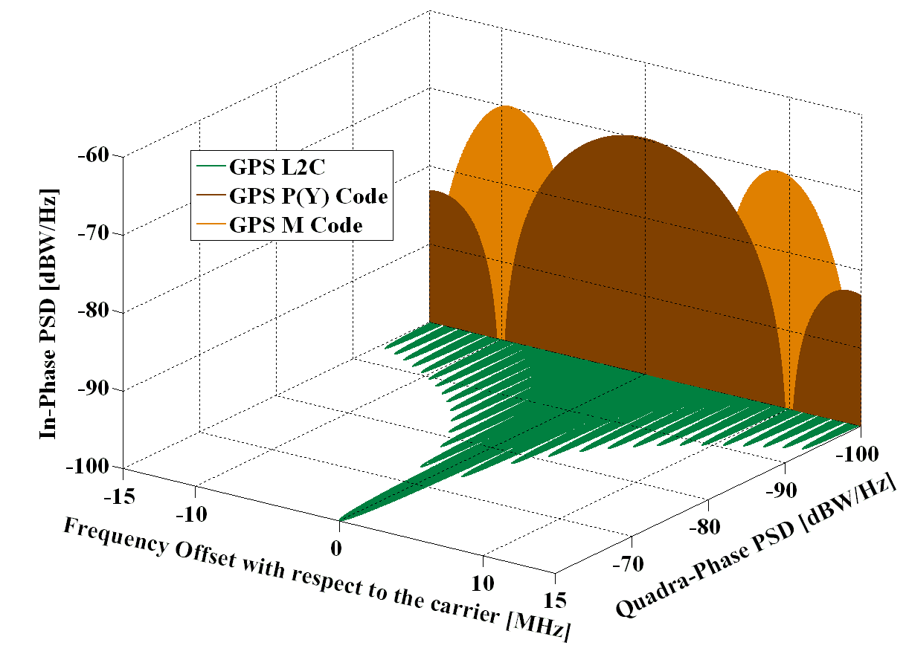
Introduction (4/8)
Spectra of the GPS Signals in L2 (*)
(*) Wikipedia: http://www.navipedia.net/index.php/GPS_Signal_Plan

Slide 6
Introduction (5/8)
L2 CM/CL code timing relationship
Fig. 3-12 of IS-GPS-200H

Slide 7
Introduction (6/8)
CNAV message
Fig. 3-14 of IS-GPS-200H
½ ficxed convolutional code + CRC-24Q
Viterbi Decoder / Fano Decoder
Same as Galileo I/NAV

Slide 8
Introduction (7/8)
Message structure of CNAV
Forward error correction (FEC) encoded by 1/2 convolutional code.
Transmit a complete ephemeris every 48 seconds.

Slide 9
Introduction (8/8)
CNAV Message contents
Type No. | Message Content | Max. Broadcast Intervals
10 | Ephemeris | 48 seconds
11 | Ephemeris | 48 seconds
30-37 | Clock | 48 seconds
30 | Inter-Signal Correction and Ionospheric Data | 288 seconds
33 | UTC | 288 seconds
35 | GPS/GNSS Time Offset | 288 seconds
31 or 12 | Reduced Almanac | 20 minutes
34 or 13 | Differential Correction | 30 minutes
32 | Earth Orientation Parameters | 30 minutes
14 | Differential Correction | 30 minutes
37 | Midi Almanac | 2 hours
36 or 15 | Text Message | Not determined
Requisite for receiver fix:
Type 10
Type 11
Any one of 30-37

Slide 10
SDR processing procedure

Slide 11
initSettings.m (1/2)
Acquisition settings
- Single sideband for carrier freq. search
settings.acqSearchBand = 5000;
- Coherent integration time for acquisition can be set to 0 -20 (ms) by users
settings.acqCohT = 20;
- Carrier freq. search step
settings.acqStep = 1000/settings.acqCohT/2;
- Sampling rate threshold for downsampling
If input signal sampling freq. is too high for FFT computation, it can be resampled to a lower freq. to save processing time.
settings.resamplingThreshold = 8e6;
- Enable/dissable use of downsampling for acquisition
settings.resamplingflag = 1; % 0 – Off, 1 - On

Slide 12
initSettings.m (2/2)
Tracking loops settings
- PLL and DLL integration time equals the CM code length
settings.intTime = 0.02;
Code parameter setting
- L2 CM code rate is 0.5115 Mcps, and the code length is 10230 chips.
settings.codeLength = 10230;
settings.codeFreqBasis = 0.5115e6;
Velocity computation setting
- L2 carrier frequency
settings.carrFreqBasis = 1227.60e6;
- Half number of carrier frequencies used to do Doppler smoothing
settings.dopSmoothNr = 2;

Slide 13
acquisition.m (1/14)
Acquisition Method
- Circular correlation by Zero-padding FFT
- Perfect correlation can be obtained even when navigation bit is changed.
- Computation is doubled.

Slide 14
acquisition.m (2/14)
Acquisition Method
- Circular correlation by Zero-padding FFT

Slide 15
acquisition.m (3/14)
Acquisition Method
- Circular correlation by Zero-padding FFT
Case 3

Slide 16
acquisition.m (4/14)
Selectable downsampling
- Computational load
setsettings.acqCohT = 20;
setsettings.samplingFreq = 53e6;
- Computers crash all the time with MATLAB.
- How to settle this problem?
2120000-point FFT
Downsampling
How?

Slide 17
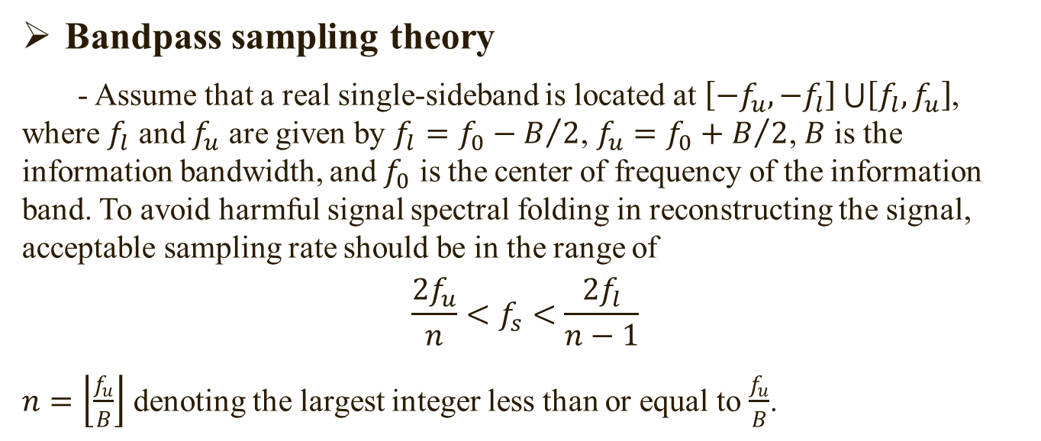
acquisition.m (5/14)
Bandpass sampling theory
- Assume that a real single-sideband is located at $\left[−f_{u},−f_{l}\right]\bigcup{\left[f_{l},f_{u}\right]}$, where $f_{l}$ and $f_{u}$ are given by $f_{l}=f_{0}−B/2$, $f_{u}=f_{0}+B/2$, $B$ is the information bandwidth, and $f_{0}$ is the center of frequency of the information band. To avoid harmful signal spectral folding in reconstructing the signal, acceptable sampling rate should be in the range of
$$\frac{{2f}_{u}}{n}<f_{s}<\frac{{2f}_{l}}{n−1}$$
$n=\left\lfloor \frac{f_{u}}{B}\right\rfloor$ denoting the largest integer less than or equal to $\frac{f_{u}}{B}$.

Slide 18
acquisition.m (6/14)
Acquisition implementation
- Selectable downsampling
(1) Filter out signal power outside the main lobe of CM code to avoid spectral folding
fs = settings.samplingFreq;
IF = settings.IF;
BW = 1.2e6*2;
w1 = (IF)-BW/2;
w2 = (IF)+BW/2;
wp = [w1*2/fs-0.002 w2*2/fs+0.002];
b = fir1(700,wp);
longSignal = filtfilt(b,1,longSignal);
Power spectral density after digital bandpass filtering

Slide 19
acquisition.m (7/14)
Acquisition implementation
- Selectable downsampling
(2) Calculate upper and lower boundary of the acceptable sampling Freq. range:
fu = settings.IF + BW/2;
n = floor(fu/BW);
if (n<1)
n = 1;
end
lowerFreq = 2*fu/n;
fl = settings.IF - BW/2;
if(n>1)
upperFreq = 2*fl/(n-1);
else
upperFreq = lowerFreq;
end

Slide 20
acquisition.m (8/14)
Acquisition implementation
- Selectable downsampling
(3) Find downsampling frequency
Take the center of the acceptable sampling Freq. range as downsampling frequency.
settings.samplingFreq = ceil((lowerFreq + upperFreq)/2);
(4) Downsample input IF signals
signalLen = floor((length(longSignal)-1) /oldFreq * settings.samplingFreq);
index = ceil((0:signalLen-1)/settings.samplingFreq * oldFreq);
index(1) = 1;
longSignal = longSignal(index);

Slide 21
acquisition.m (9/14)
Acquisition implementation
- Selectable downsampling
(5) Equivalent IF after downsampling
Resampling is equivalent to down-converting the original IF by integer times of resampling freq.
settings.IF = rem(settings.IF,settings.samplingFreq);
Power spectral density after downsampling

Slide 22
acquisition.m (10/14)
Acquisition implementation
- Coarse acquisition
Finding the second largest peak is a little different from the L1 C/A SDR.
…
codePhaseRange = [leftRange rightRange];
…

Slide 23
acquisition.m (11/14)
Acquisition implementation
- Fine acquisition
Signal length (findLen) used to do fine acquisition depends on settings.acqCohT.
if(settings.acqCohT <=10)
findLen = samples10msLength;
else
findLen = samplesXmsLen;
end
- Change fine acquisition results to correspond with original sampling frequency, if downsampling is carried out.
acqResults.codePhase(PRN) = floor((codePhase - 1)/ ...
settings.samplingFreq *oldFreq)+1;
doppler = acqResults.carrFreq(PRN) - settings.IF;
acqResults.carrFreq(PRN) = doppler + oldIF;

Slide 24
acquisition.m (12/14)
Acquisition Results
Processing time of acquisition
 | With Downsampling* | Without Downsampling**
Elapsed time | 255.8 second | 2624.3 second
(*) settings.acqCohT = 10; settings.resamplingflag = 1; settings.acqSatelliteList = 1:32;
(**) settings.acqCohT = 10; settings.resamplingflag = 0; settings.acqSatelliteList = 1:32;

Slide 25
acquisition.m (13/14)
Acquisition Results
With Downsampling*
Without Downsampling**
(*) settings.acqCohT = 10; settings.resamplingflag = 1; settings.acqSatelliteList = 1:32;
(**) settings.acqCohT = 10; settings.resamplingflag = 0; settings.acqSatelliteList = 1:32;

Slide 26
acquisition.m (14/14)
Acquisition Results
PRN | With Downsampling* |  | Without Downsampling**
 | Doppler | Code offset | Doppler | Code offset
12 | -1459 | 193394 | -1463 | 193391
6 | 1033 | 356347 | 1039 | 356345
5 | -3497 | 701963 | -3504 | 701962
25 | -3030 | 621140 | -3030 | 621139
17 | 1181 | 879013 | 1190 | 879015
24 | 1534 | 829119 | 1525 | 829115
29 | -2928 | 933179 | -2935 | 933174
(*) settings.acqCohT = 10; settings.resamplingflag = 1; settings.acqSatelliteList = 1:32;
(**) settings.acqCohT = 10; settings.resamplingflag = 0; settings.acqSatelliteList = 1:32;

Slide 27
tracking.m (1/4)
A 3-order PLL was used to improve dynamic performance of carrier tracking

Slide 28
tracking.m (2/4)
PLL filter coefficients calculation
[pf3,pf2,pf1] = calcLoopCoefCarr(settings);
NCO update
d2CarrError = d2CarrError + carrError * pf3;
dCarrError = d2CarrError + carrError * pf2 + dCarrError;
carrNco = dCarrError + carrError * pf1;
Save remCodePhase for pseudorange calculation
trackResults(channelNr).remCodePhase(loopCnt) = remCodePhase;

Slide 29
tracking.m (3/4)
Tracking results
- With complex IF data set
(L2_USRPL1L2_1950secIn_fs_4e6_if20e3_schar.bin) – referred to as Data Set 1
Both PLL and DLL work well.
PRN # 29

Slide 30
tracking.m (4/4)
Tracking results
- With scalar IF data set (L2c_60s.bin) – referred to as Data Set 2
DLL works well and position accuracy is acceptable.
PLL tracking of all channels not stable.
Why?
PRN # 12

Slide 31
generateCMcode.m (1/3)
Characteristics of CM code
The maximal polynomial is 1112225171 (octal) of degree 27.
Initialized at the P-coder X1 epoch.
PRN is assigned to PRN #1-63 and #159-210.
Short cycled every count period of 10,230

Slide 32
generateCMcode.m (2/3)
Generating procedure
- (1) Set generating polynomial
RegPos = [4 7 9 12 15 17 19 22 23 24 25];
- (2) Initial-state table (See “IS-GPS-200H” for more details)
l2cm_init = [...];
- (3) Select initial states for PRN
if (PRN >= 1 && PRN <= 63)
shiftPos = PRN;
elseif(PRN >= 159 && PRN <= 210)
shiftPos = PRN - 95;
elseif ( PRN < 1 || PRN > 210 || (PRN >= 64 && PRN <= 158) )
disp(' PRN does not exist! ');
return;
End
code_init = l2cm_init(shiftPos);

Slide 33
generateCMcode.m (3/3)
Generating procedure
- (4) Covert octal format to binary bit and fill in shift register
reg = dec2bin(oct2dec(code_init)) - 48;
reg = [zeros(1,27-length(reg)) reg];
- (5) Generate CM code
CMcode = zeros(1,CodeLength);
for index = 1:CodeLength
CMcode(index) = reg(end);
reg = circshift(reg',1)';
reg(RegPos) = reg(RegPos) * CMcode(index);
end

Slide 34
makeCMTable.m (1/1)
Return zero (RZ) CM code are generated
cmCode = generateCMcode(PRN,settings);
cmCode = [cmCode;zeros(1,length(cmCode))];
cmCode = reshape(cmCode,1,[]);

Slide 35
postNavigation.m (1/3)
Main changes
- CNAV data and ephemeris decoding
See “CNAVdecoding.m” and “ephemeris_L2CM.m”
- Calculation of signal transmitting time
See “calculatePR_PRR.m”
- Calculation of pseudorange and rate
See “calculatePR_PRR.m”
- Position and Velocity computation for SVs
See “satposvel_L2C.m”
- Add velocity computation
See “leastSquarePosVel.m”

Slide 36
postNavigation.m (2/3)
Main changes
- Start and end of measurement points
Measurement point begins at the latest start of first messages of all channels (firstSubFrame), and consider Doppler smoothing
for channelNr = activeChnList
sampleStart(channelNr) = ...
trackResults(channelNr).absoluteSample(firstSubFrame(channelNr));
sampleEnd(channelNr) = trackResults(channelNr).absoluteSample(end);
End
…
- Correct pseudorange rate for SV clock rate error
clkCorrRawPRat = rawPRat(activeChnList) + satClkCorrRat * settings.c;
localTime = localTime + measSampleStep/settings.samplingFreq ;

Slide 37
postNavigation.m (3/3)
Main changes
- Correct and save local time
localTime = localTime - xyzdt(4)/settings.c;
navSolutions.localTime(currMeasNr) = localTime;
- Convert velocity in ECEF to ENU
Use function “ECEF2ENU.m”
- Save velocity results
navSolutions.Ve(currMeasNr) = ENU(1);
…
- Update local time
Except first time, local time is updated by measurement step
localTime = localTime + measSampleStep/settings.samplingFreq ;

Slide 38
CNAVdecoding.m (1/4)
Viterbi decoder algorithm
MATALB function: decoded = vitdec(code,trellis,tblen,opmode,dectype)

Slide 39
CNAVdecoding.m (2/4)
Implementation procedure

Slide 40
CNAVdecoding.m (3/4)
Implementation details
- Prepare trellis description for Viterbi decoder
trellis = poly2trellis(7,[171 133]);
- Search the first G1 output bit and do Viterbi decoding
for bitSync = 1:2
decodedBits = vitdec(I_P_InputBits(bitSync:end-(bitSync-1)),
trellis,tblen,'trunc','hard');
…
end
- Find all possible preambles
index = find(round(abs(tlmXcorrResult(xcorrLength : xcorrLength * 2 - 1))) == 8.00)';
- Correct polarity of the CNAV data bits
if(~isequal(navBits(1:8),preamble_01))
navBits = not(navBits);
End

Slide 41
CNAVdecoding.m (4/4)
Implementation details
- CRC-24Q check
See MATLAB Communications System Toolbox for details
crcDet = comm.CRCDetector([24 23 18 17 14 11 10 7 6 5 4 3 1 0]);
[~,frmError] = step(crcDet,navBits(1:300)')
- Ephemeris decoding and TOW
See “ephemeris_L2CM.m”
- “firstSubFrame”
Start position of the first message in I_P stream
firstSubFrame = index(i) * 2 + bitSync - 2;

Slide 42
ephemeris_L2CM.m (1/1)
Ephemeris decoding
- No special technique is needed.
- For more details, refer to “IS-GPS-200H”.
Compute TOW of the first message
- Every message lasts 12 second.
TOW = bin2dec(navBitsBin(21:37)) * 6 - 12;

Slide 43
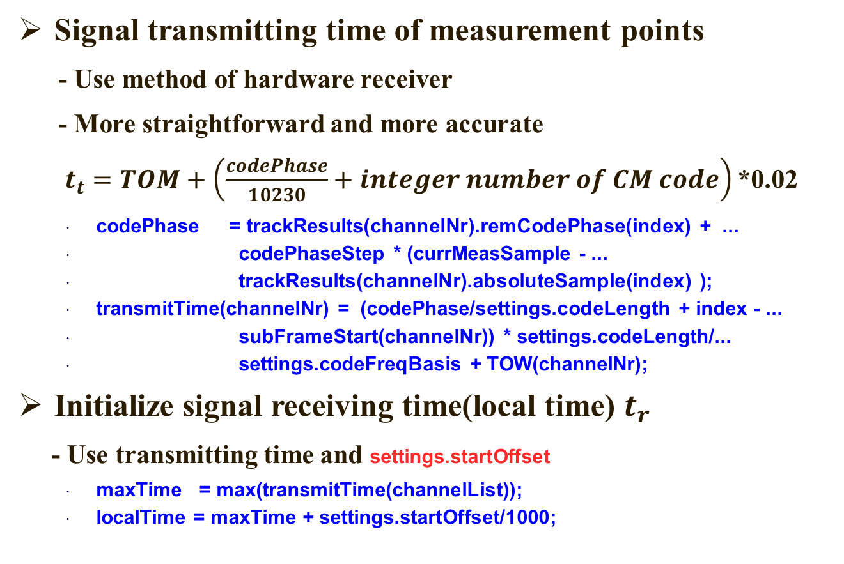
calculatePR_PRR.m (1/2)

Slide 44
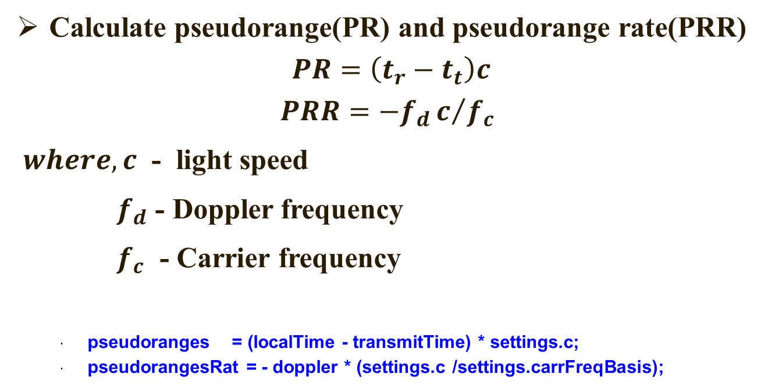
calculatePR_PRR.m (2/2)
pseudoranges = (localTime - transmitTime) * settings.c;
pseudorangesRat = - doppler * (settings.c /settings.carrFreqBasis);

Slide 45
satposvel_L2C.m (1/3)
SV position calculation differences from L1 C/A SDR
- Semi-Major Axis at reference time
A_0 = A_REF + eph(prn).deltaA;
A = A_0 + eph(prn).ADot * tk;
- Mean motion difference from computed value
delta_n = eph(prn).delta_n_0 + 0.5 * eph(prn).delta_n_0Dot *tk;
- Rate of right ascension
omegaDot = omegaDot_REF + eph(prn).delta_omegaDot;
Inter-Signal Correction depends on decoding of message type # 30 (IS-GPS-200H, P171)
if(eph(prn).idValid(3) == 30)
satClkCorr(satNr) = satClkCorr(satNr) - eph(prn).T_GD + eph(prn).ISC_L2C;
end

Slide 46
satposvel_L2C.m (2/3)
SV velocity calculation
- Same as using NAV ephemeris
- No special technique is needed. For more details, refer to:
Korvenoja P., Piche R. Efficient satellite orbit approximation. Proceeding of ION GPS, Salt Lake City, UT, Sep. 19-22, 2000.

Slide 47
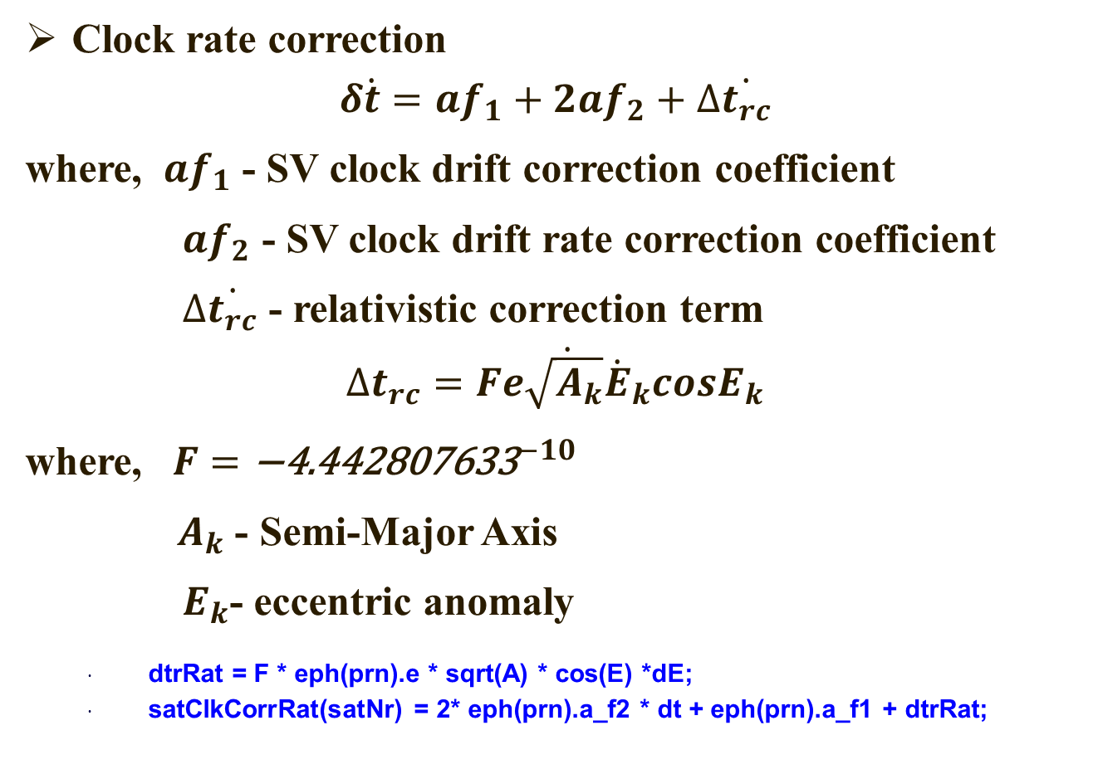
satposvel_L2C.m (2/3)
Clock rate correction
$$δ\dot{t}=af_{1}+2af_{2}+∆\dot{t_{rc}}$$
where, $af_{1}$ - SV clock drift correction coefficient
$af_{2}$ - SV clock drift rate correction coefficient
$∆\dot{t_{rc}}$ - relativistic correction term
$$∆\dot{t_{rc}=Fe\sqrt{A_{k}}{\dot{E}}_{k}cosE_{k}}$$
where, $F={\text{−}\text{4.442807633}}^{−10}$
$A_{k}$ - Semi-Major Axis
$E_{k}$- eccentric anomaly
dtrRat = F * eph(prn).e * sqrt(A) * cos(E) *dE;
satClkCorrRat(satNr) = 2* eph(prn).a_f2 * dt + eph(prn).a_f1 + dtrRat;

Slide 48
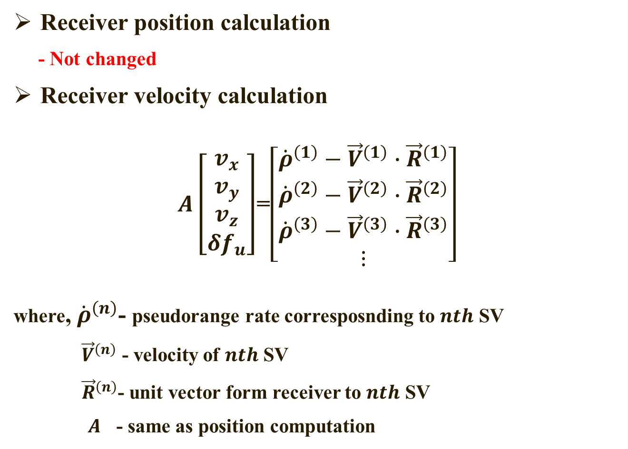
leastSquarePosVel.m (1/2)
Receiver position calculation
- Not changed
Receiver velocity calculation
$A\left[\begin{matrix}v_{x} \\ v_{y} \\ v_{z} \\ {δf}_{u}\end{matrix}\right]$=$\left[\begin{matrix}{\dot{ρ}}^{\left(1\right)}−{\vec{V}}^{\left(1\right)}∙{\vec{R}}^{\left(1\right)} \\ {\dot{ρ}}^{\left(2\right)}−{\vec{V}}^{\left(2\right)}∙{\vec{R}}^{\left(2\right)} \\ {\dot{ρ}}^{\left(3\right)}−{\vec{V}}^{\left(3\right)}∙{\vec{R}}^{\left(3\right)} \\ ⋮\end{matrix}\right]$
where, ${\dot{ρ}}^{\left(n\right)}$- pseudorange rate corresposnding to $nth$ SV
${\vec{V}}^{\left(n\right)}$ - velocity of $nth$ SV
${\vec{R}}^{\left(n\right)}$- unit vector form receiver to $nth$ SV
$A$ - same as position computation

Slide 49
leastSquarePosVel.m (2/2)
Receiver velocity calculation
for i = 1:nmbOfSatellites
rvetor = (satpos(:, i) - pos(1:3)')/ norm(satpos(:, i) - pos(1:3)', 'fro');
omcPRat(i) = ObsPRat(i) - dot(satvel(:, i), rvetor);
end
vel = A \ omcPRat;

Slide 50
Fix results (1/2)
With Data Set 2

Slide 51
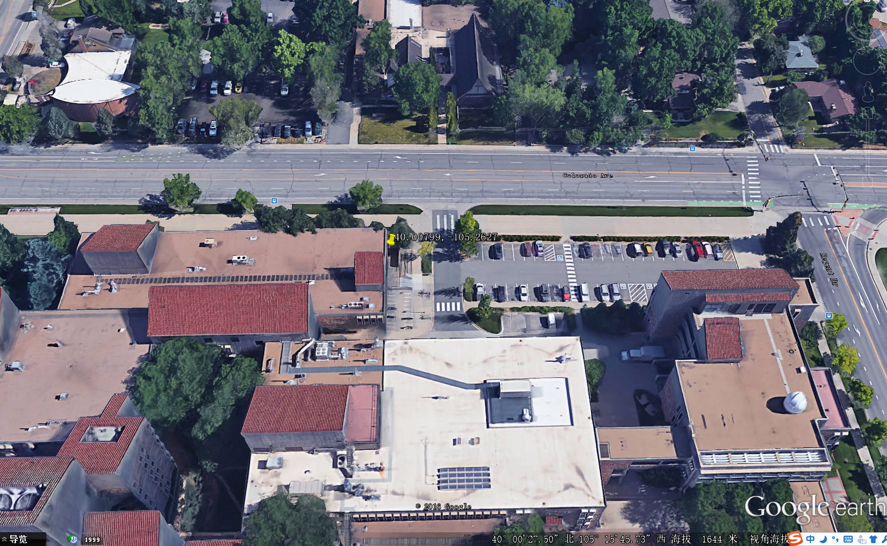
Fix results (1/2)
With Data Set 2

Slide 52

Still unresolved problems (1/2)
Receiver velocity calculation
- With Data Set 1
Doppler values of all channels are opposite to the true values.
By adding the following lines in “leastSquarePosL2CM.m”, right velocities can be obtained
if (settings.fileType == 2)
omcPRat(i) = ObsPRat(i) + dot(satvel(:, i), rvetor);
else
omcPRat(i) = ObsPRat(i) - dot(satvel(:, i), rvetor);
end

Slide 53
Still unresolved problems (2/2)
Receiver velocity calculation
- With Data Set 2
Doppler and velocity values of all channels are
completely wrong.

Slide 54
References
IS-GPS-200H, Navstar GPS Space Segment/Navigation User Interfaces. Sep. 24, 2013.
Korvenoja P., Piche R. Efficient Satellite Orbit Approximation. Proceeding of ION GPS, Salt Lake City, UT, Sep. 19-22, 2000.
Yi-Ran Sun. Generalized Bandpass Sampling Receivers for Software Defined Radio. Doctoral thesis. 2006.
Hang Yin. An Adaptive Multi-frequency GPS Tracking Algorithm, GPS CNAV Message Decoding, and Performance Analysis. Master thesis. 2014.

Slide 55
Future Works
Refine the SDR
- Advanced algorithm
- Processing speed
- Clear Comment
Add L2 CL code acquisition, tracking and PVT computation
- Improve sensitivity

Slide 56

Thank you! Yafeng Li @ Beijing institute of technology lyf8118@126.com

